Slide 1
Unlocked Packages
Vishwanath C
Game Integration
Salesforce Developer
Salesforce

Slide 2

What is a Package ?
If you’re new to packaging, you can think about a package as a container that you fill with metadata. It contains a set of related features, customizations, and schema. You use packages to move metadata from one Salesforce org to another.

Slide 3
Different types of salesforce packages
UnManaged Package – Unmanaged package is used to distribute open source applications to provide developers with with basic functionality. – We can edit unmanged package components after installing the unmanaged package in a salesforce organization. – The developer who created unmanged package has no control on installed components, can’t edit & can’t upgrade.
Managed Package – Managed package is used to distribute and sell application to customers. By using the App exchange developers can sell and mange user baser based licence to the managed package application. – Managed packages are fully upgradable. – To ensure seamless upgrades, certain destructive changes, like removing objects or fields, can not be performed.
Unlocked Package

Slide 4

Unlocked Packages
Salesforce Unlocked Packages are a new way to manage and distribute your Salesforce application. With unlocked packages, you can create a portable and modular version of your application that can be easily installed and managed across multiple Salesforce orgs. Unlocked packages give you more control over your application, allowing you to manage dependencies, versioning, and release management.

Slide 5
Commonly used commands to create and install unlocked packages
sfdx force:auth:web:login -a DevHubUsername
This command is used to login to your DevHub Salesforce Org.
sfdx force:package:create --name Packag --description "Unlocked Package for HelloWorld Apex Class" --packagetype Unlocked --targetdevhubusername DevHubUsername --path force-app
This command is used to create a unlocked package. You can specify the package name, description, and other metadata.
sfdx force:package:version:create --package HelloWorldPackage --path force-app --targetdevhubusername DevHub --wait 10 --installation-key test1234
This command is used to create a version for the unlocked package. Whenever you update the metadata in this package, you don’t need to create another package, Instead you can just version it up and deploy to salesforce org.
sfdx force:package:install -p HelloWorldPackage@0.1.0-3 -u EA-Salesforce
This command is used to install your unlocked package into any salesforce org. You can either choose to use this command or directly click on the URL you get after versioning the package.

Slide 6
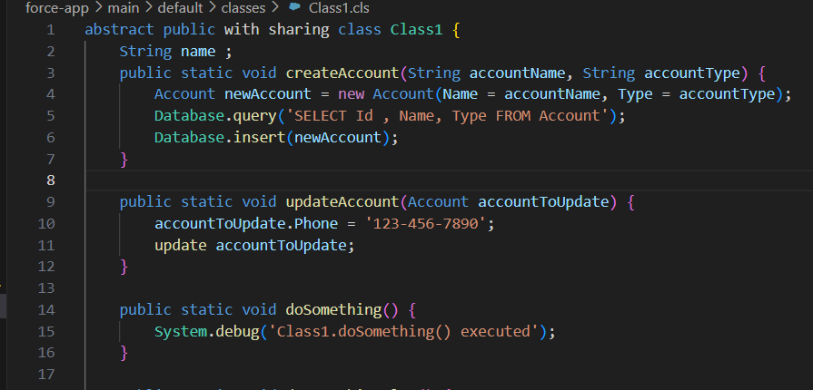
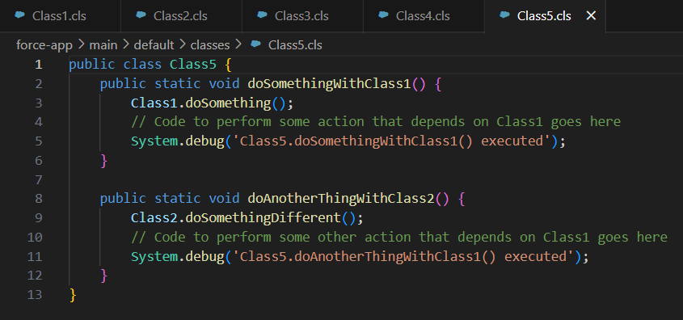
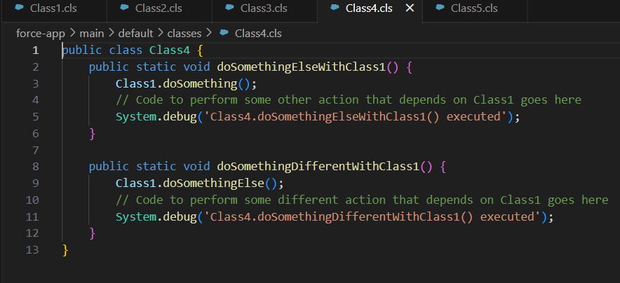
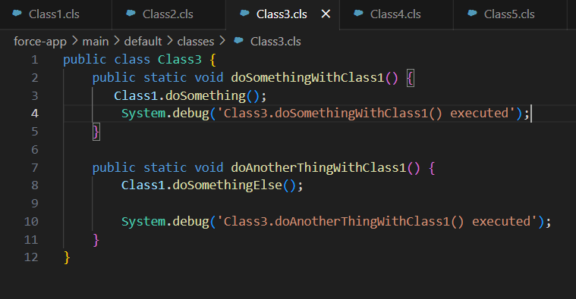

Slide 7
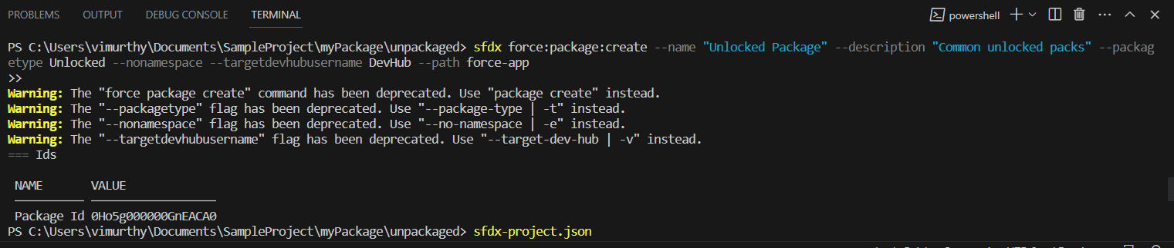
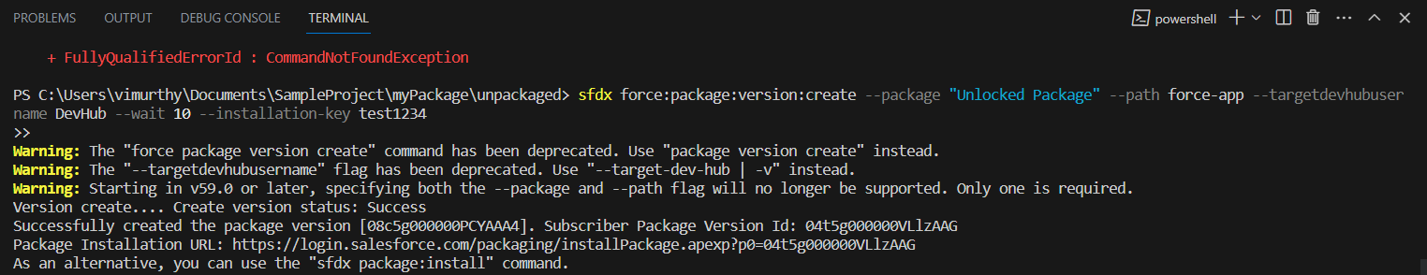

Slide 9


Salesforce
Metadata
Apex Class 1
Apex Class 2
Apex Class 3
Apex Class 4
Deploying into Salesforce Database
Salesforce Database

Slide 10

Dependencies
Dependent on
Apex Class 2
Apex Class 1
Dependent on
Apex Class 3
Apex Class 1
Dependent on
Apex Class 4
Apex Class 1

Slide 11



Apex Class 2
Apex Class 3
Apex Class 4
Apex Class 1
Breaking the dependencies or
Separating the dependencies
Unlocked Package 1
Unlocked Package 2

Slide 12
Unlocked Package 1
Unlocked Package 2
Installing the packages
Salesforce won't be able to find the necessary dependencies when they are compiled, resulting in compilation errors or runtime errors
Salesforce Database

Slide 13
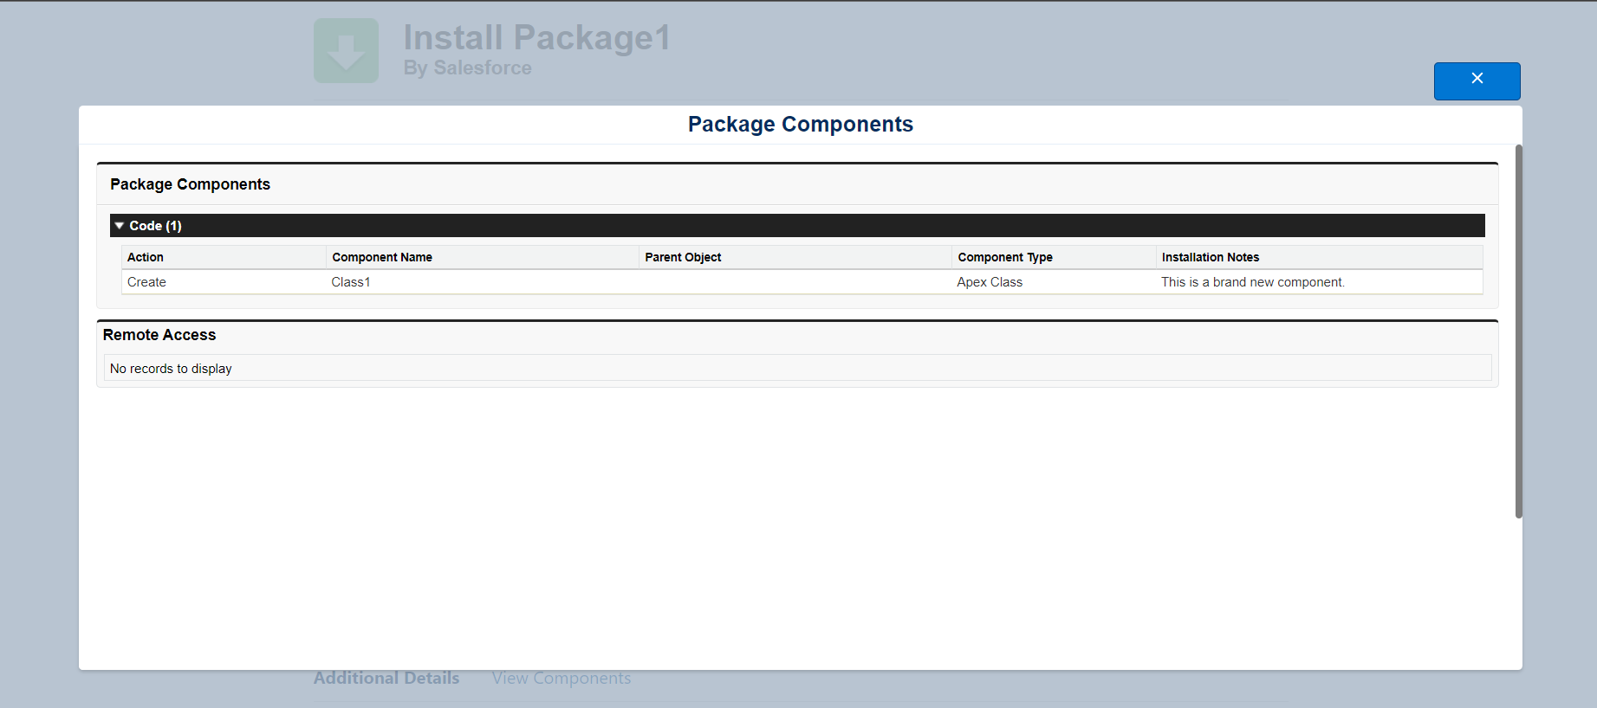
Errors while installing the dependent packages

Slide 14
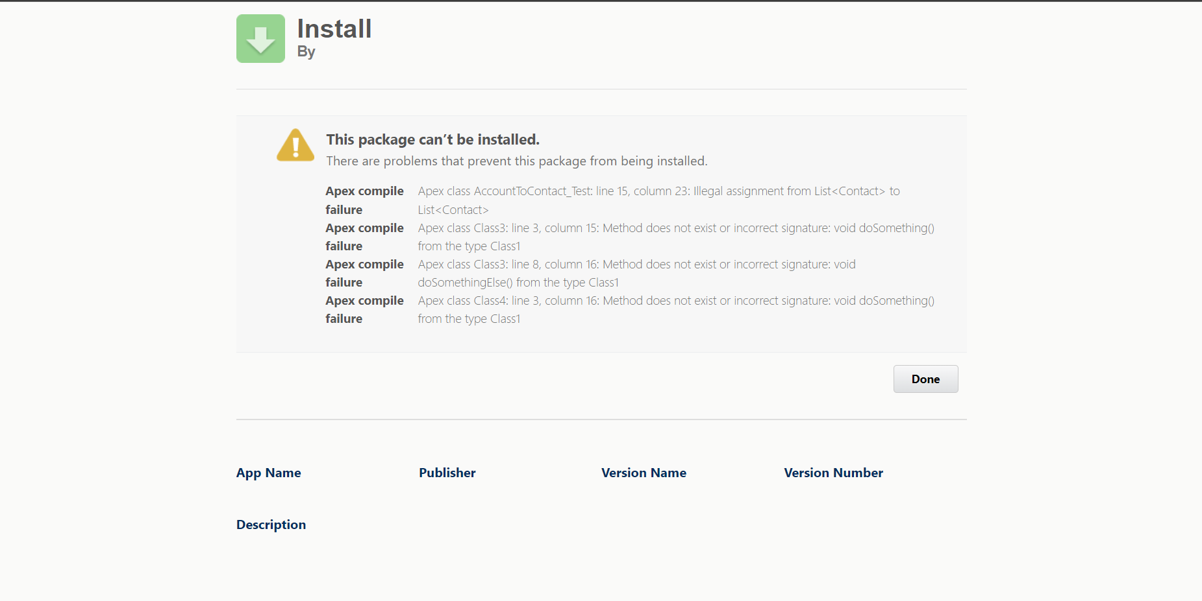
Installation Error In Salesforce

Slide 15

Conclusion
We can't install the classes that are dependent on each other in different packages
In the context of Salesforce Unlocked Packages, the statement "We can't install the classes that are dependent on each other in different packages" can be further elaborated.
Salesforce Unlocked Packages are a packaging mechanism provided by Salesforce that allows developers to bundle and distribute their custom code, configuration, and metadata. Unlocked Packages are modular and promote modularity, reusability, and version control within the Salesforce platform.
When it comes to installing classes with interdependencies in different Unlocked Packages, there are certain considerations and limitations:
Package Boundaries: Unlocked Packages establish boundaries between different modules of an application. Each package has its own namespace and encapsulates its components, including classes. Dependencies across package boundaries can exist, but they need to be managed and resolved appropriately.
Package Dependencies: Unlocked Packages can have dependencies on other packages. These dependencies are specified in the package manifest file, which outlines the components required by the package. If classes in one package depend on classes in another package, the dependent package needs to be explicitly specified as a dependency.
Managed Dependencies: In Salesforce, managed packages are packages created by Salesforce partners and distributed through the AppExchange. Managed packages have a higher level of encapsulation and control, and their classes are typically not accessible outside the package boundary. Therefore, dependencies on managed package classes can present additional challenges.
Namespace Considerations: Unlocked Packages have their own namespaces, which help prevent naming conflicts between components. When classes have dependencies, they should be aware of each other's namespaces and references. If classes are in different packages, the namespace and package names must be appropriately referenced to avoid naming collisions.
Considering these factors, it is generally recommended to organize classes with dependencies within the same Unlocked Package. Placing dependent classes in the same package ensures that they are readily accessible to each other and simplifies their installation and management. If dependencies exist across packages, it is crucial to define and manage those dependencies properly through package metadata and namespace references.
In conclusion, while it is possible to have class dependencies across different Salesforce Unlocked Packages, it is advisable to structure and organize the classes in a way that minimizes cross-package dependencies. By doing so, developers can ensure better modularity, maintainability, and ease of installation within the Salesforce Unlocked Packages framework.

